Slide 1

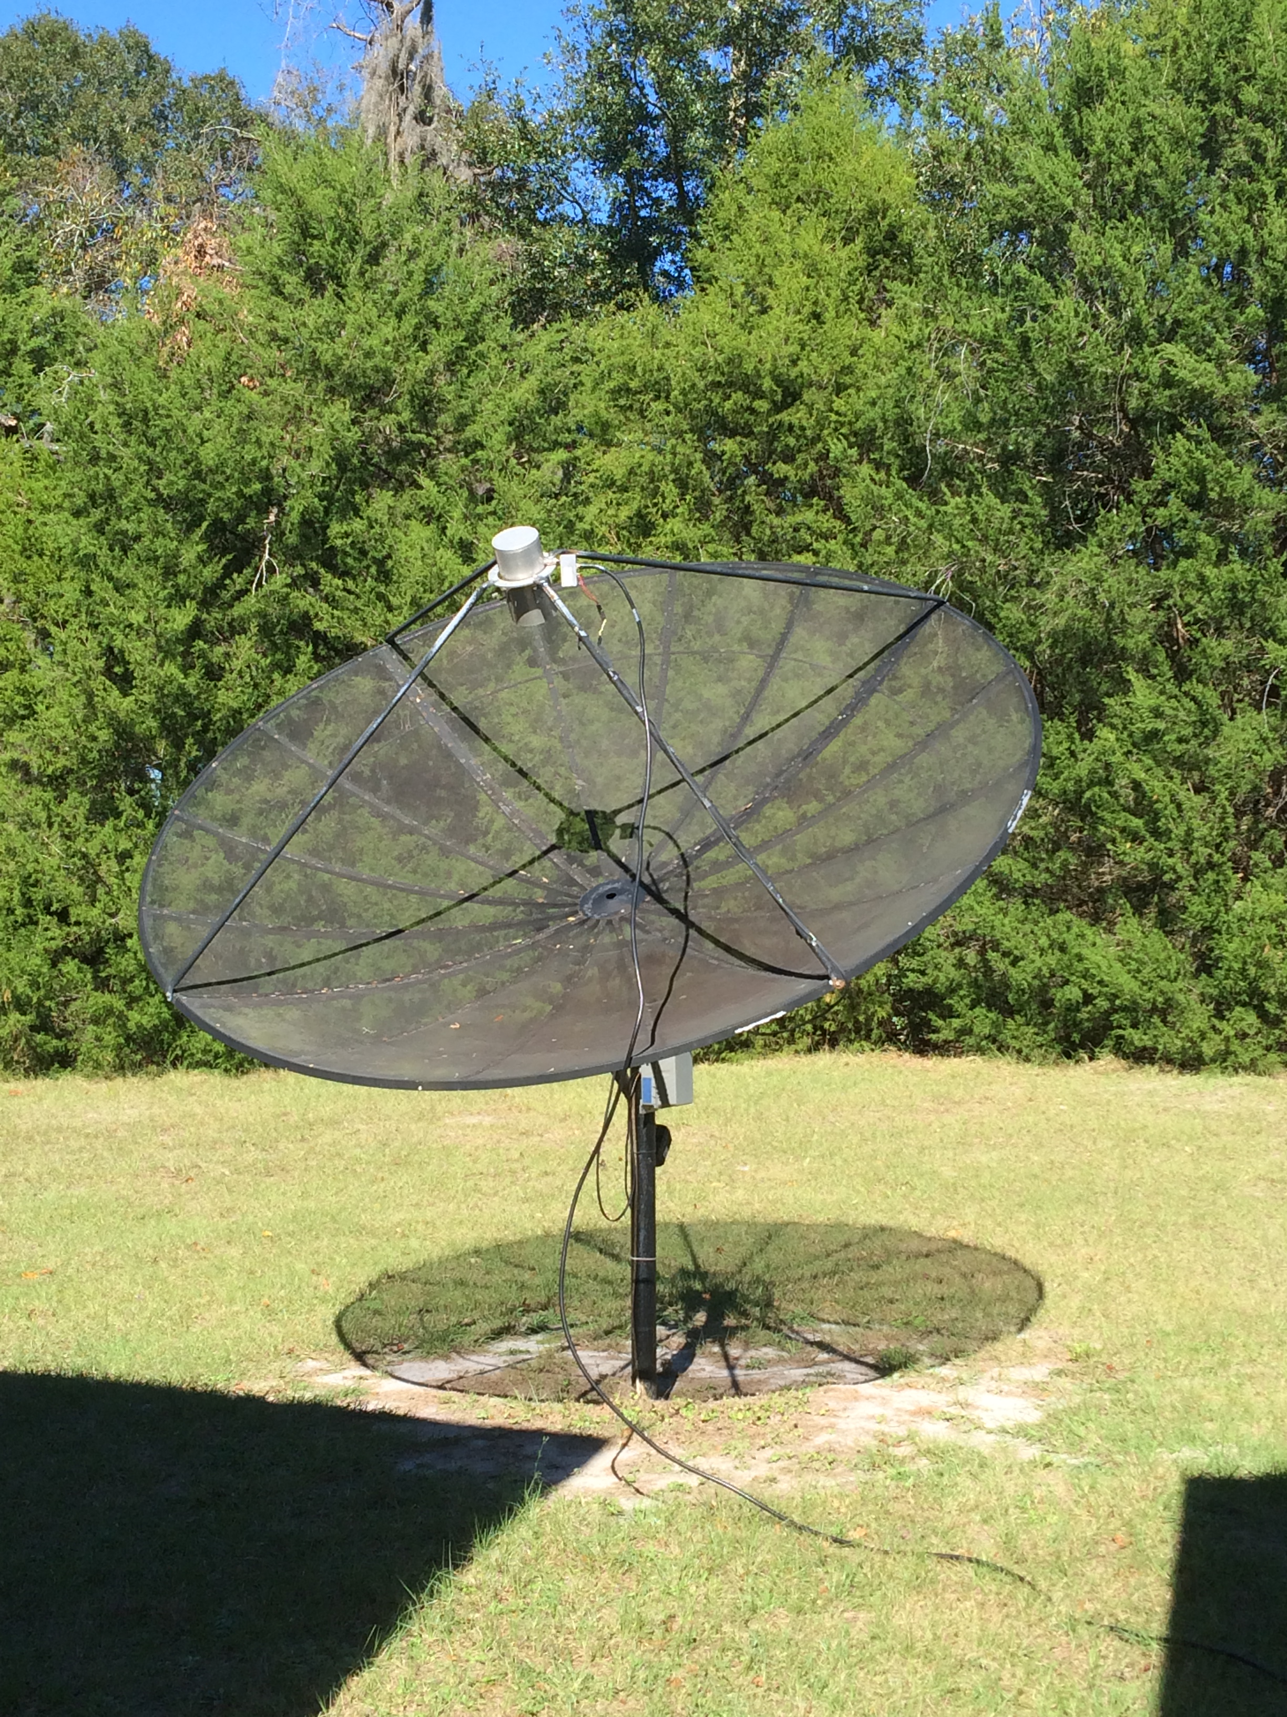
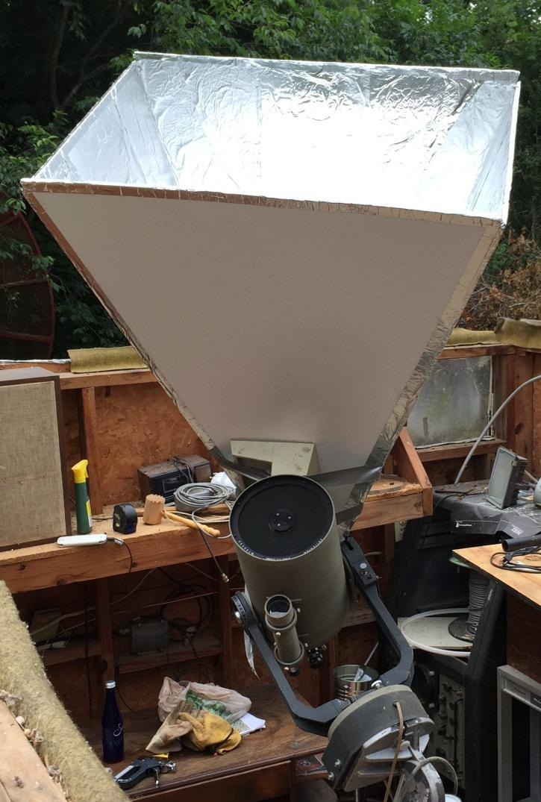
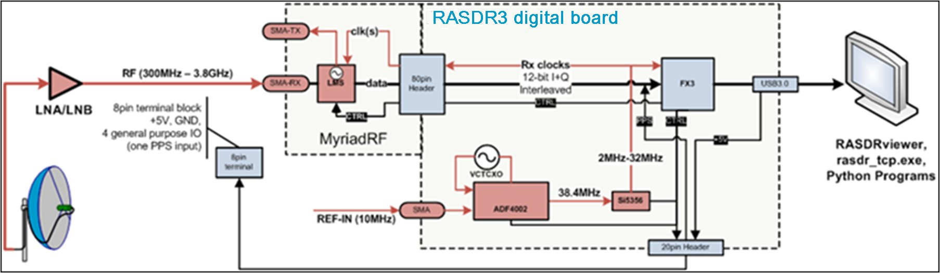
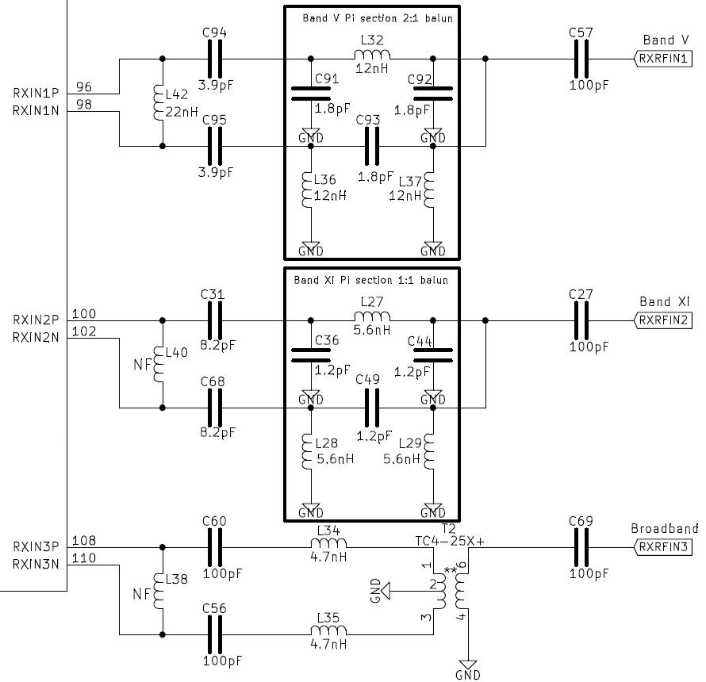
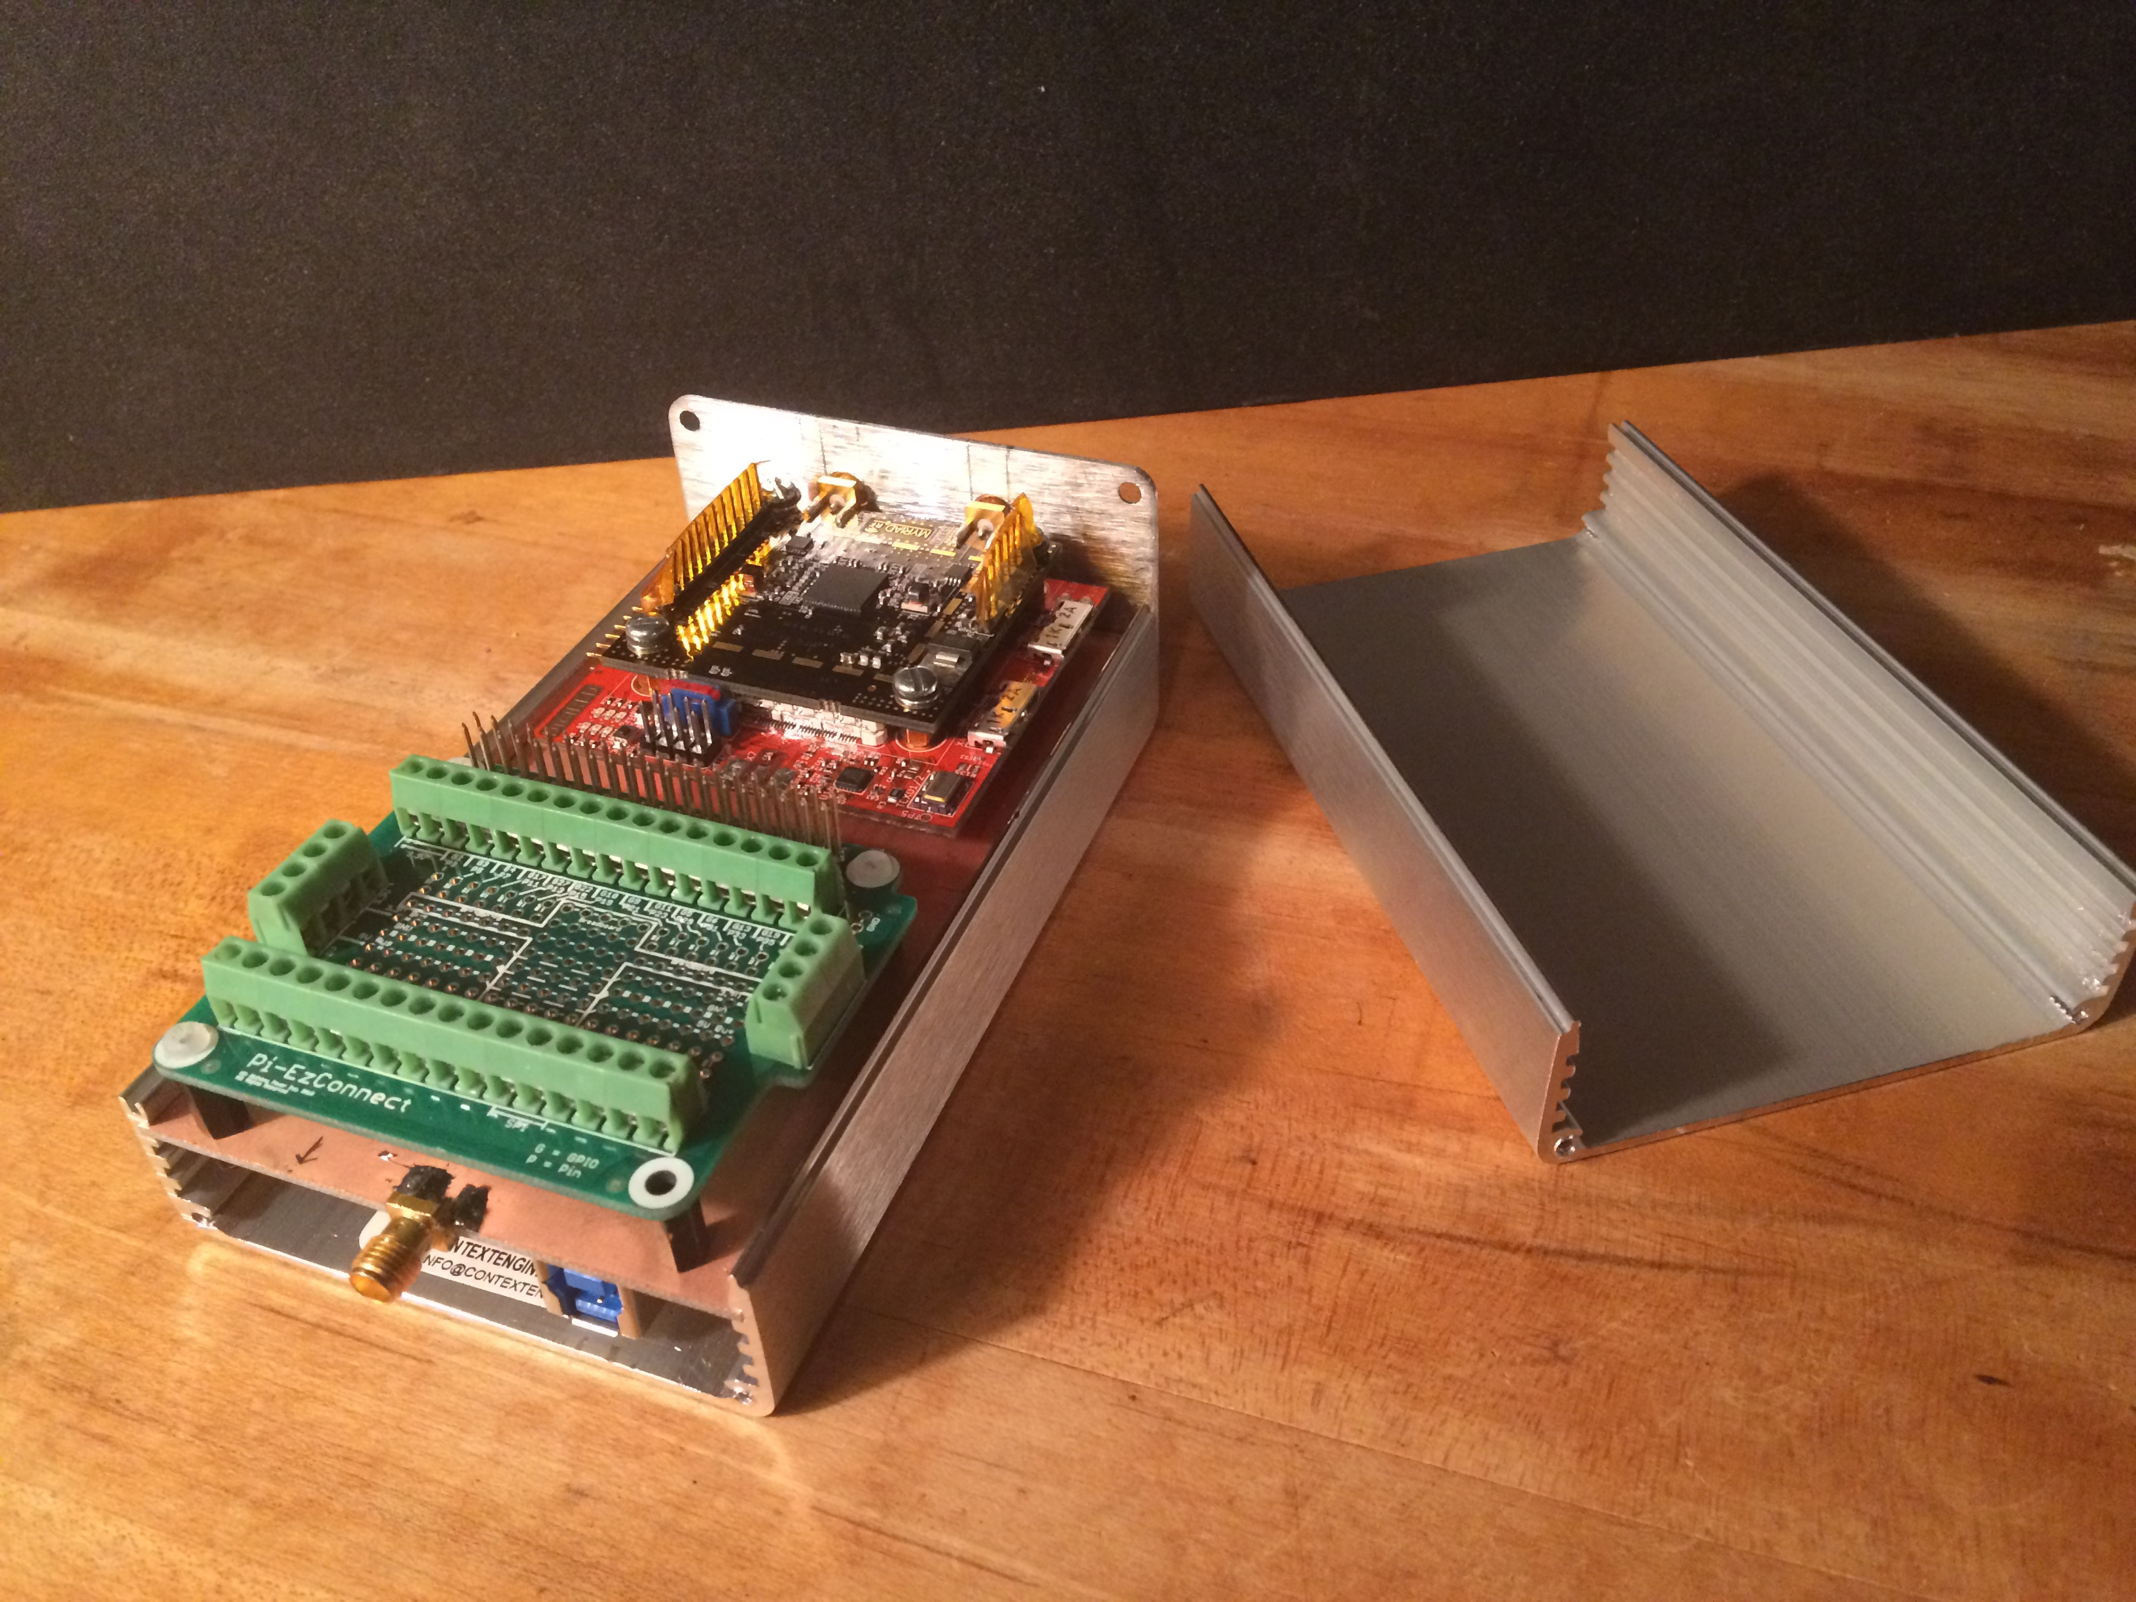
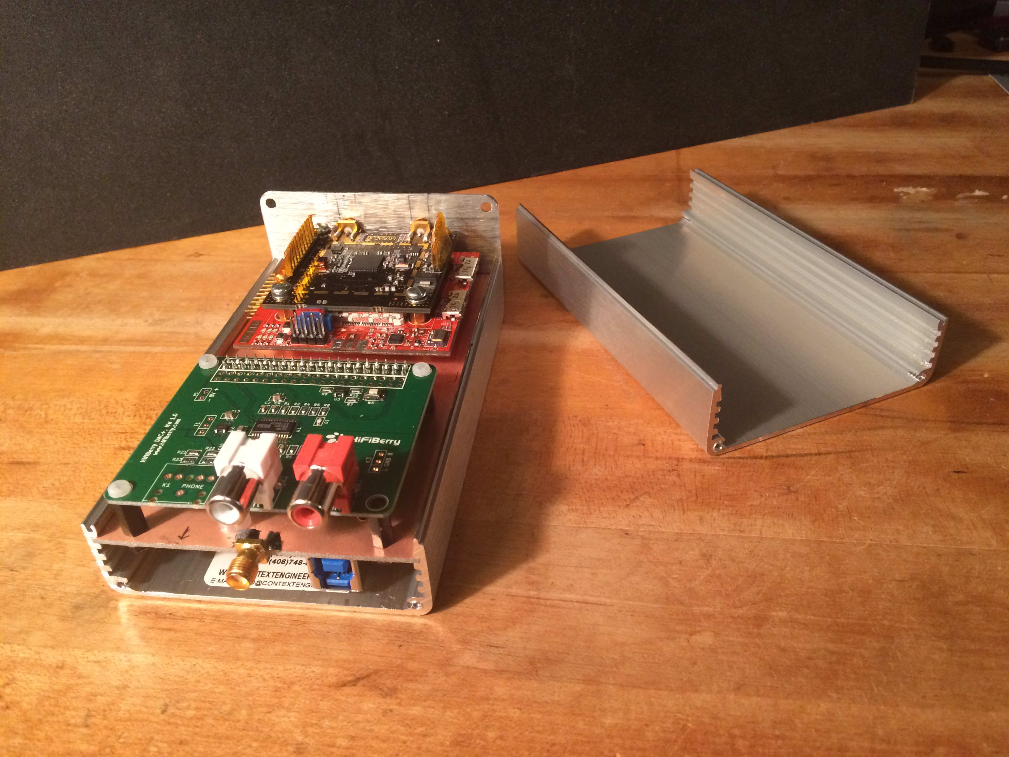
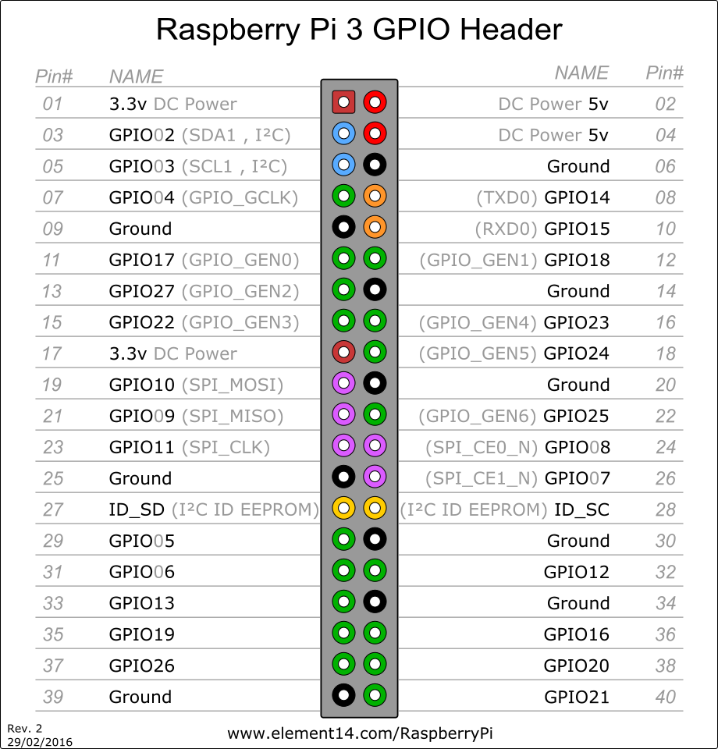
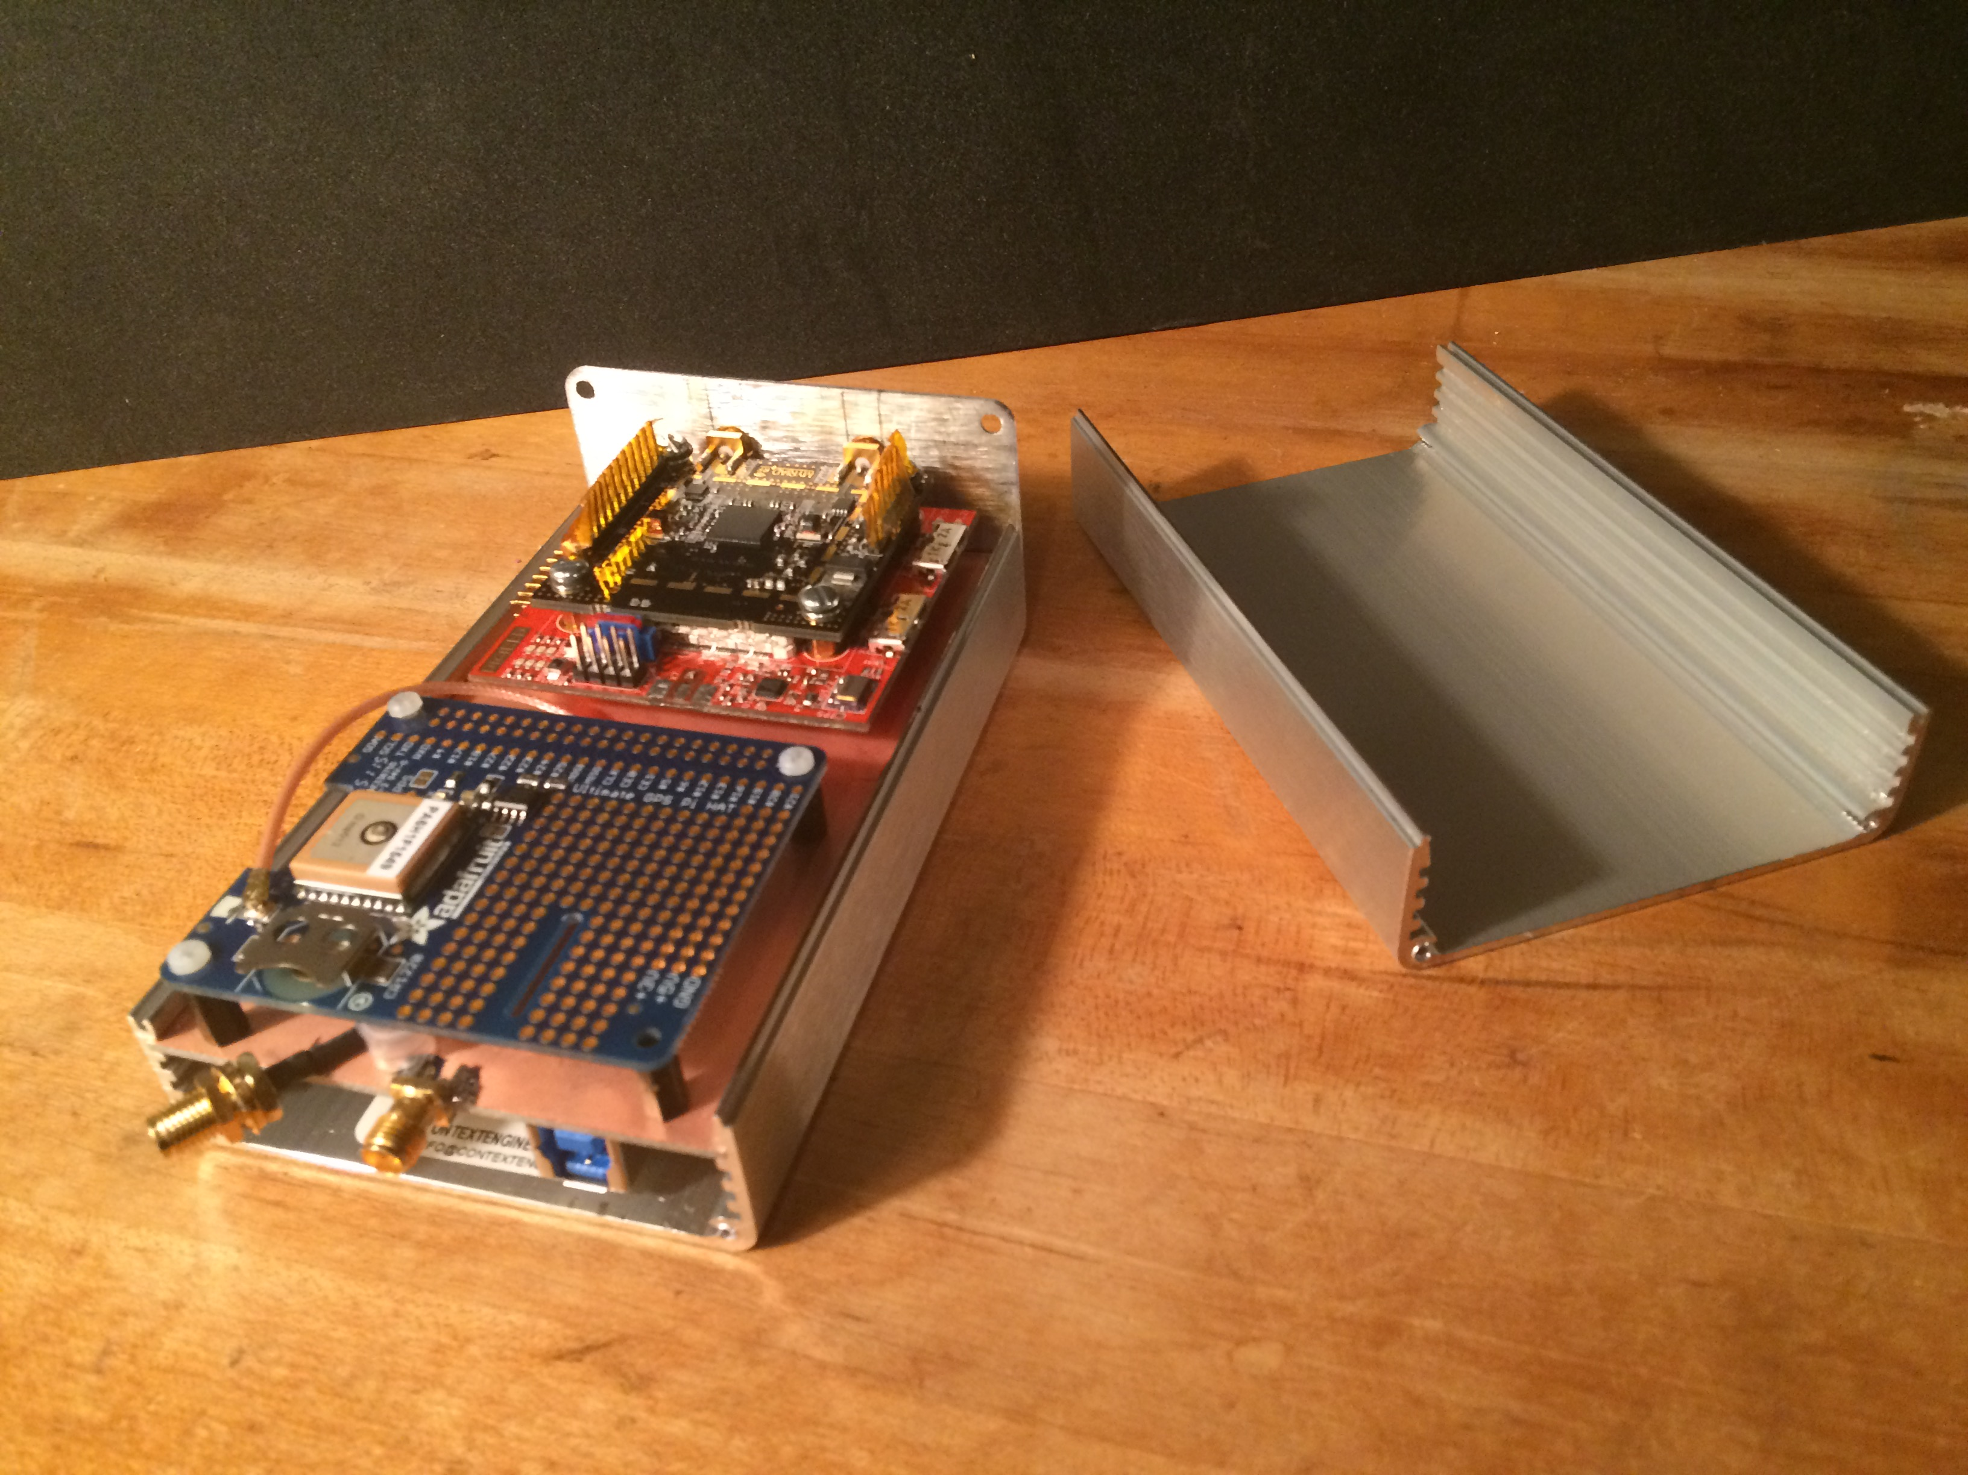
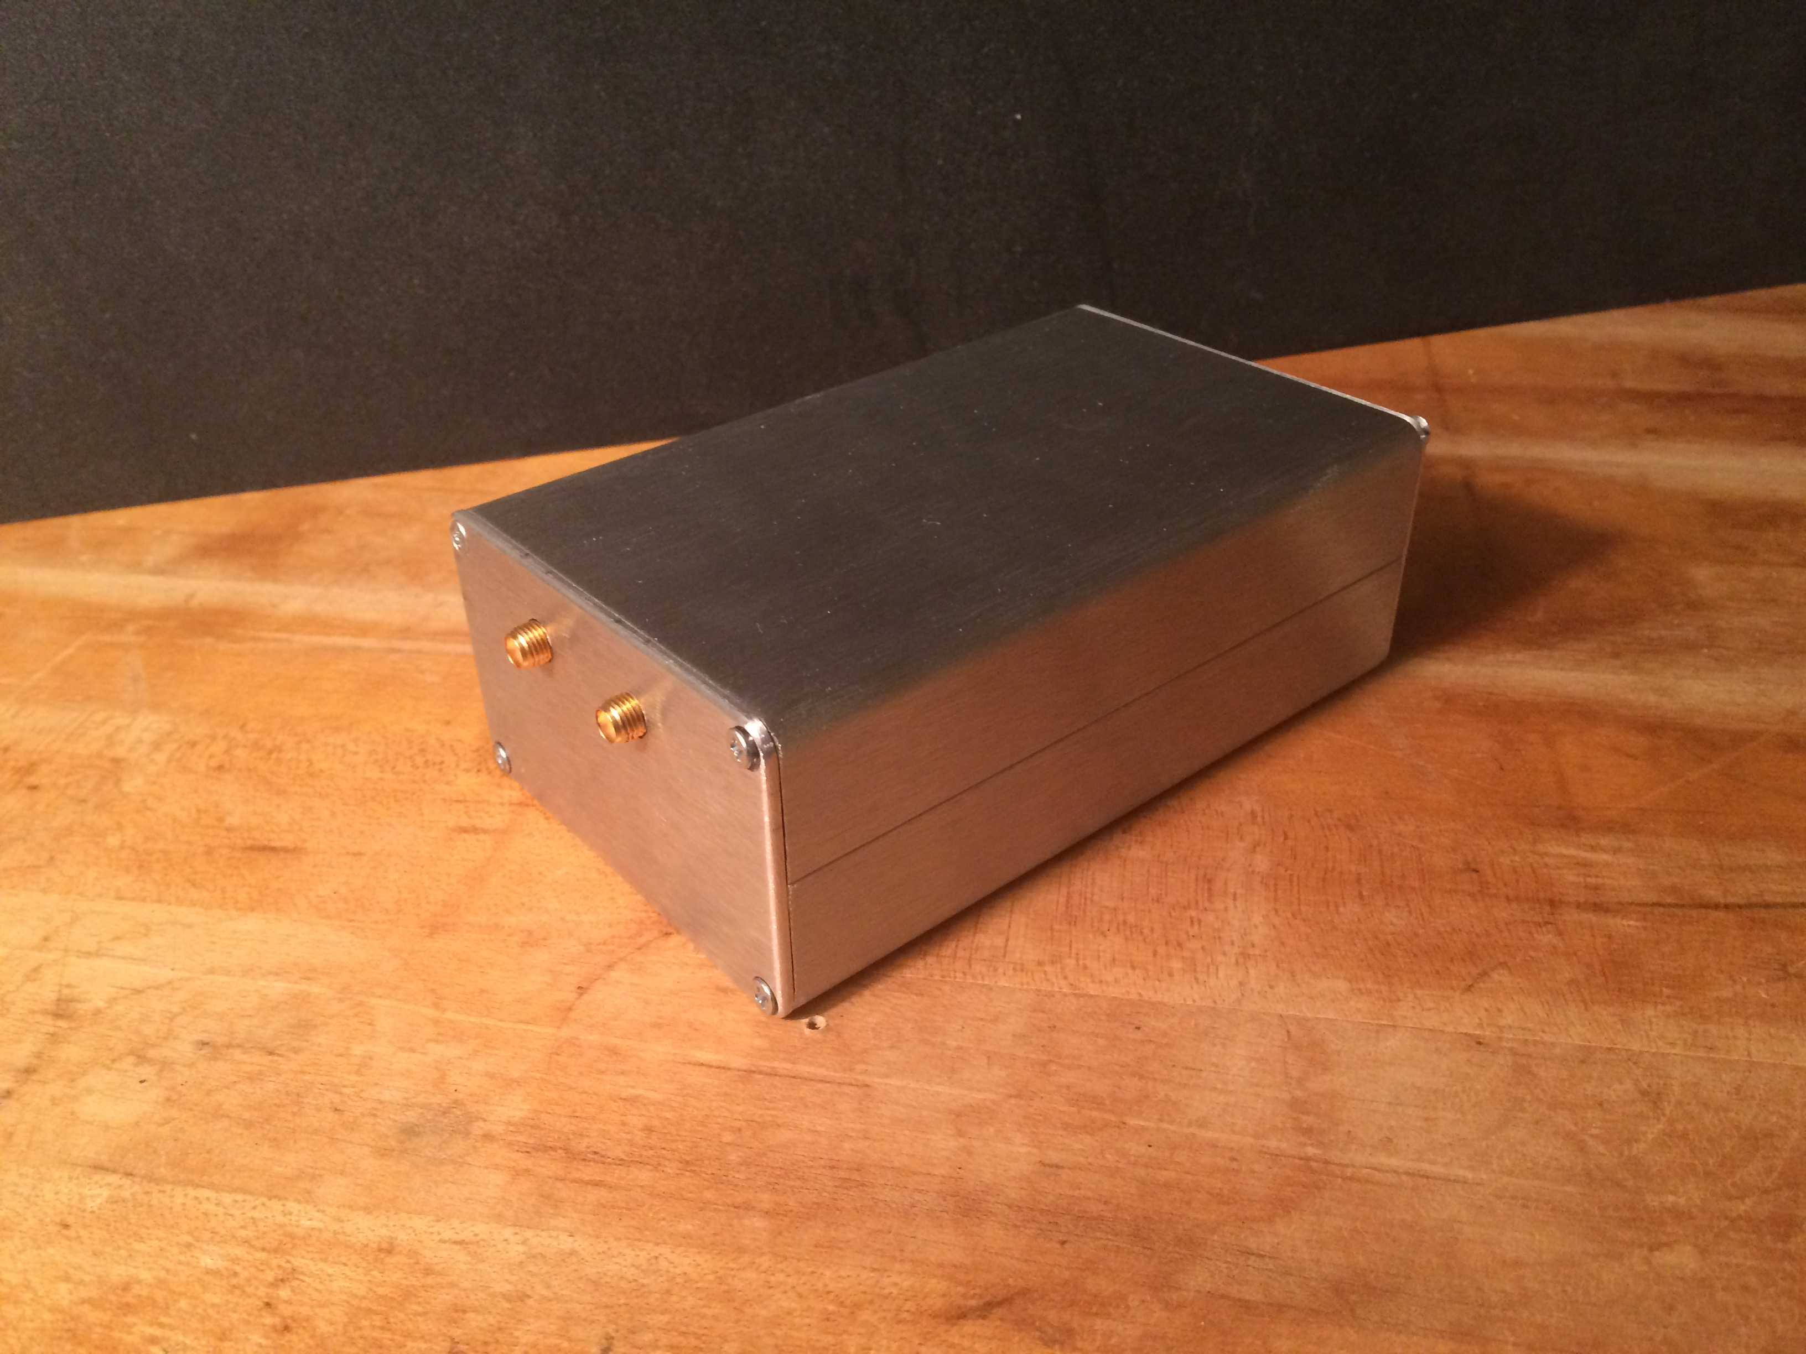
RF Chain and Front End
The Radio Astronomy Software Defined Receiver (RASDR) is an Open Hardware project undertaken by members of the Society of Amateur Radio Astronomers(SARA) to develop a low cost, high performance software defined receiver for use by SARA members.
RASDR3 Base System Contents
RF Transceiver Diagram
Features
Two channel simultaneous receive at 1.5MHz-28MHz bandwidth (adjustable)
Field Programmable RF Transceiver tuning between 400MHz and 3.8GHz
12 bit I/Q sampling at 30.72MHz
Maximum data transfer rate of 160MB/sec (using USB3)
External reference clock input, enabling synchronous operation with test equipment and facility timing signals
External general purpose I/O on a terminal block
Pulse-Per-Second is available via a GPS module add-in card.
Maximum receiver gain 61dB
Open Hardware, Open Source Software
RF Front End Circuit
Pre-Order Today!
RASDR3
Mock-Up
Electrical Specifications
USB3 or USB2 with data rate of 160MB/s or 35MB/s respectively
SMA receive input, 50ohm, 300MHz-3.8GHz, 23dBm maximum
SMA reference clock input, 50ohm, 10MHz
SMA transmit output, CW only, 50ohm, 300MHz-3.8GHz, 6dBm
RASDR3 is the *only* software defined radio that supports add-in expansion cards. The specification follows the Raspberry PI HAT specification that allows any HAT module to be used with the RASDR3 base platform.
Kit Contents
RASDR3 PCB (fully populated)
MyradRF PCB (fully populated)
USB3 Cable
Driver/Software/Documentation CD
Extruded Aluminum Case
Quick Start/Assembly Guide
Mounting Hardware (screws, standoffs)
Initial Modules supported by the firmware (available separately) include:
GPS module (right) providing 1PPS and location/time inforrmation.
Analog output module (above, right) providing two channel output at 192KHz sampling rate
GPIO connector module (above, left)
We are currently accepting pre-ordersto fullfill our minimum order quantity requirement in order to produce the boards. If you would like to do so, please go to rasdr.com to pre-order clectronically or contact Bogdan Vacaliuc (bvacaliuc at gmail.com), for more information. The final cost depends on how many units are built. Please keep in mind that we must obtain enough pre-orders to produce a minimum number of boards. At this time, we will initiate a production run when we have received 100 pre-orders.
Acknowledgement

